Slide 1
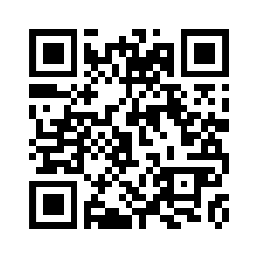
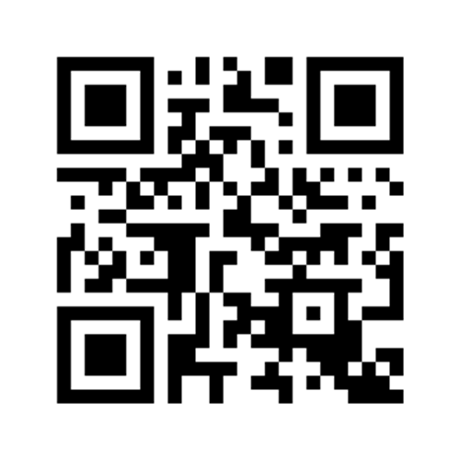
Scan to Connect to Smart Home
Local Network
Scan to Connect to IoT App Dashboard
1
2

